Slide 1
L10.01 System of difference constraints (Using Bellman-Ford to solve Linear programming problem)
50.004 Introduction to Algorithm
Dr. Simon LUI
ISTD, SUTD

Slide 2
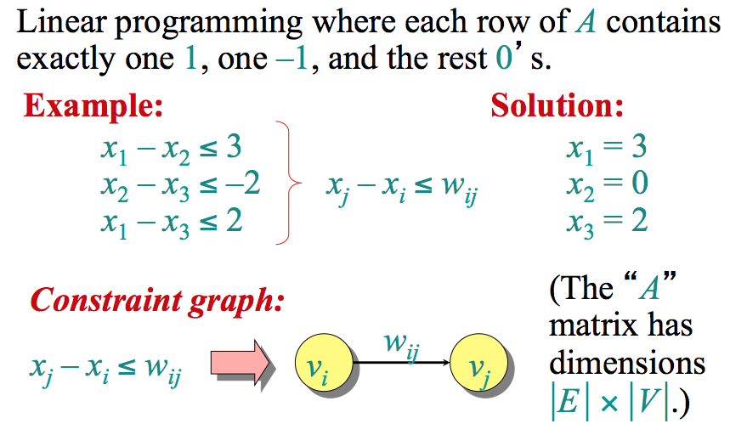
System of difference constraints
So the matrix A is:
1, -1, 0
0, 1, -1
1, 0, -1

Slide 3
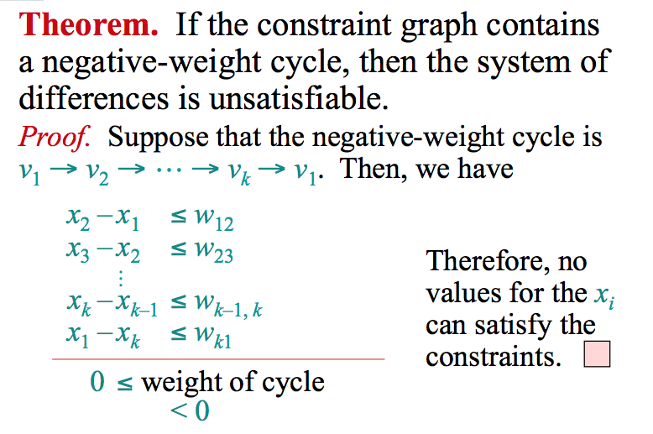
Unsatisfiable constraint

Slide 4
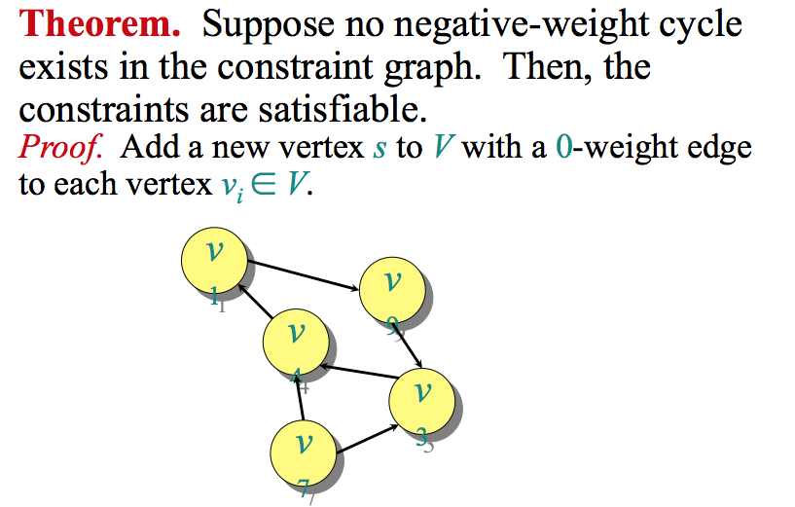
Satisfying the constraint

Slide 5
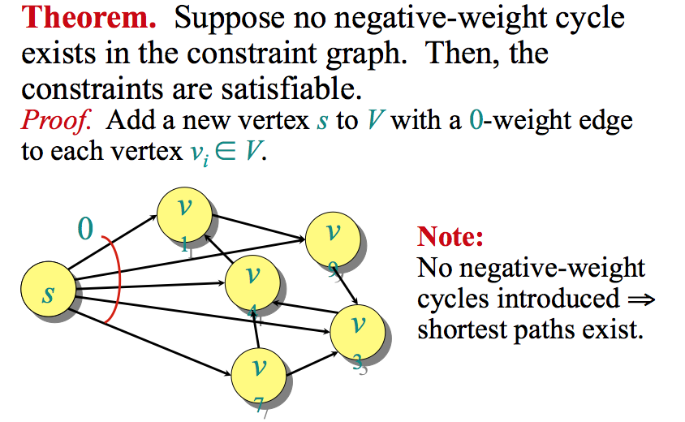
Satisfying the constraint

Slide 6
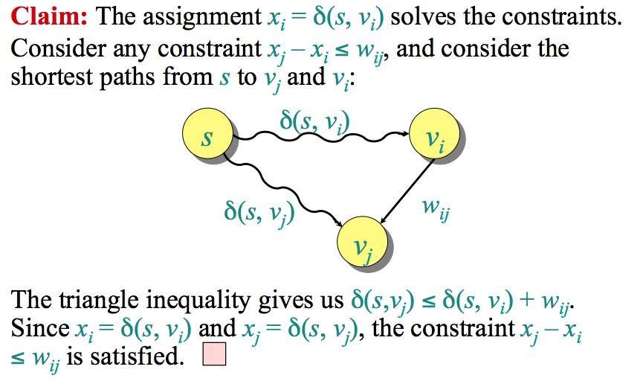
Satisfying the constraint

Slide 7
Using Bellman-Ford to solve the linear programming problem
The Bellman-Ford algorithm can solve a system of m difference constraints on n variables in O(m n) time

Slide 8
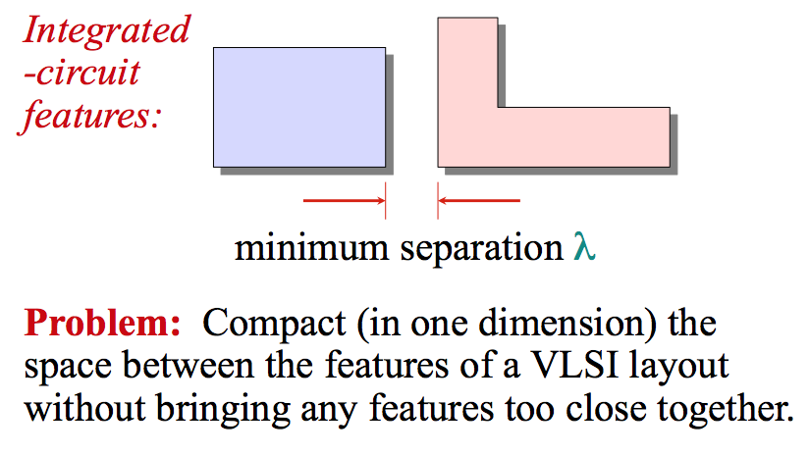
Using Bellman-Ford to solve the linear programming problem
Practical usage on circuit board:
a-b < 3
c-d < 6
e-f < 7
….

Slide 9
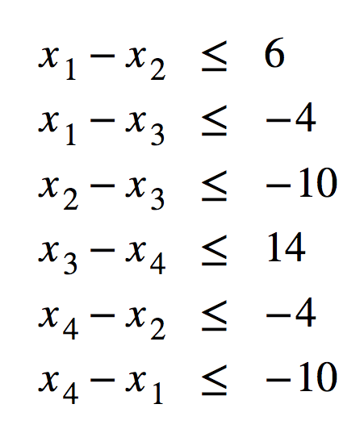
Exercise 1
Solve this with Bellman-ford algorithm: what is x1, x2, x3, x4?

Slide 10
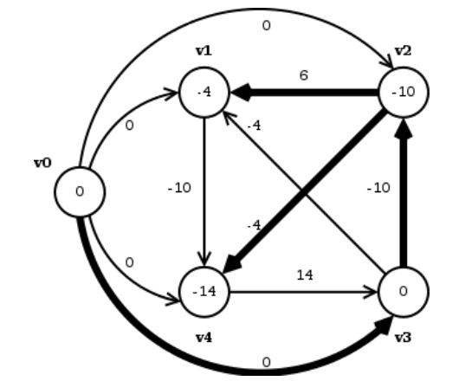
Solution 1
X1=-4, x2=-10, x3=0, x4=-14

Slide 11
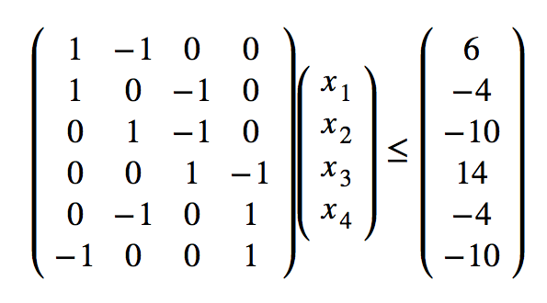
(Extra 1)
This is the matrix A….

Slide 12
Exercise 2
a – b ≤ 5
b – c ≤ -2
c – d ≤ -1
d – a ≤ 6
d – b ≤ -7
Solve a,b,c,d with Bellman-ford algorithm

Slide 13
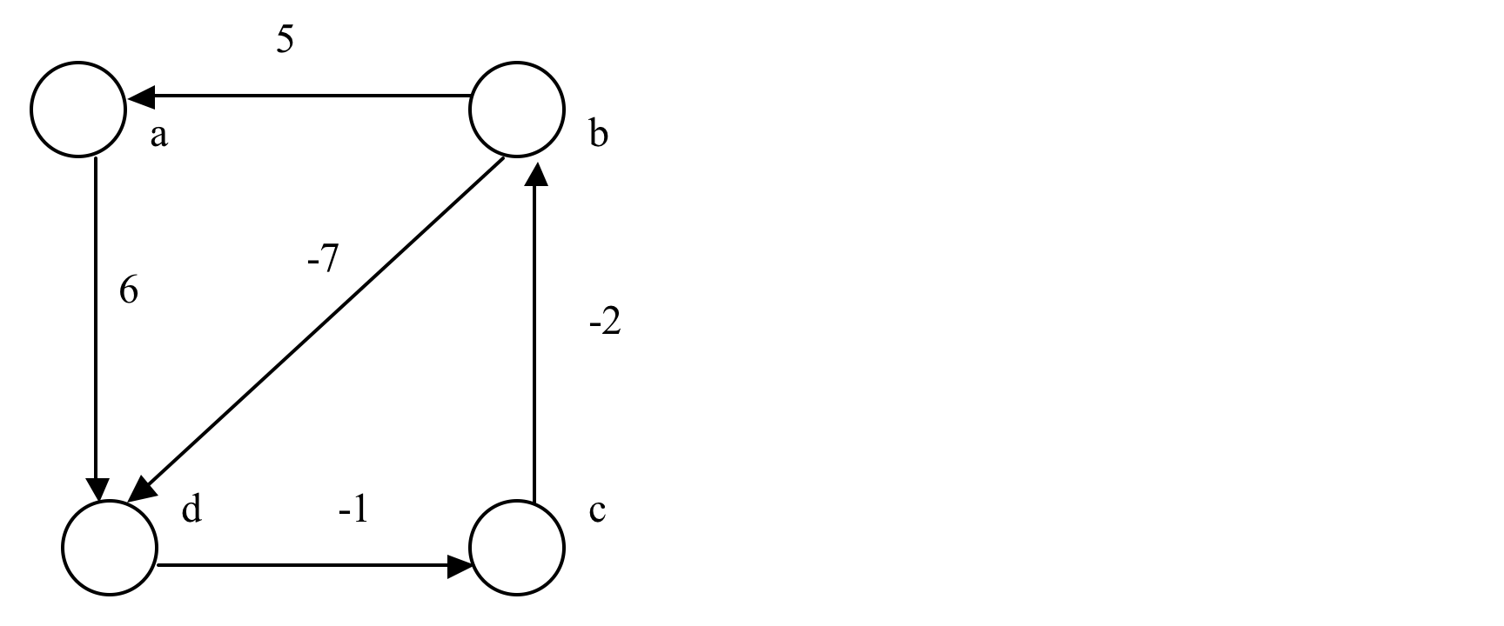
Solution 2
Negative cycle found, no solution

